Slide 1
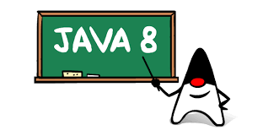
Java 8 Introduction
A new way of programming !
Author : Harsh Kava
Date : Oct 2015

Slide 2
Java Version History
Version 1.5 -> 5
To reflect level of Maturity, Stability
JDK 1.0
Oak
J2SE 1.2
Playground
J2SE 1.3
Kestrel
J2SE 1.4
Merlin
J2SE 5.0
Tiger
Java SE 6
Mustang
Java SE 7
Dolphin
Java SE 8
Spider
1996
1998
2000
2002
2004
2006
2011
2014
First release developed under the Java Community Process
J2SE -> Java SE
Dropped .0

Slide 3
Recap - Major Feature Additions in Java
Java 5
Generics,
Autoboxing
Annotations
Enhanced For-Loop, VarArgs and more…
Java 6
Script Engine
New I/O, changes to garbage collection algorithms
JVM improvements include: synchronization and compiler performance optimizations
Java 7
Strings in Switch, Catch Multiple-Exceptions
Try-with-Resource, Type Interface
JVM Support for Non-Java Languages

Slide 4
Java SE 8 New Features at glance
Lambda Expressions
Streams API
Date-Time Library
Type Annotations and Repeating Annotations
jdbc-odbc bridge removed
Nashhorn JavaScript Engine
New utilities to improve Performance, Scalability

Slide 5

Lambda Expressions
Adds functional processing capability to Java.

Slide 6
Lambda Expression
Arrow
(Person p1, Person p2) -> p1.getAge().compareTo(p2.getAge());
Lambda parameters
Lambda body
The basic syntax of a lambda is either
(parameters) -> expression
or
(parameters) -> { statements; }
Notes:
The body of a lambda expression is a block of code enclosed in braces. Like
a method's body, the body of a lambda expression may declare local variables; use statements including break,
continue, and return; throw exceptions, etc.

Slide 7
Lambda Expression
Examples:
(String s) -> s.length()
(Person p) -> p.getAge() > 20
() -> 92
() -> System.out.println("Hello World");
(int x, int y) -> x + y
() -> { return 3.1415 };
(int x, int y) -> {
System.out.println(“Result:”);
System.out.println(x + y);
}

Slide 8
Lambda Expression
Where should we use Lambda?

Slide 9
Lambda Expression
Threads can be initialized like following:
//Old way: new Thread(new Runnable() { @Override public void run() { System.out.println("Hello from thread"); } }).start(); //New way: new Thread( () -> System.out.println("Hello from thread") ).start();

Slide 10
Lambda Expression
The event handling :
//Old way: button.addActionListener(new ActionListener() { @Override public void actionPerformed(ActionEvent e) { System.out.println("The button was clicked using old fashion code!"); } }); //New way: button.addActionListener( (e) -> { System.out.println("The button was clicked. From lambda expressions !"); });

Slide 11
Lambda Expression
List handling :
//Old way: List<Integer> list = Arrays.asList(1, 2, 3, 4, 5, 6, 7); for(Integer n: list) { System.out.println(n); } //New way: List<Integer> list = Arrays.asList(1, 2, 3, 4, 5, 6, 7); list.forEach(n -> System.out.println(n)); //or we can use :: double colon operator in Java 8 list.forEach(System.out::println);

Slide 12
Lambda Expression
Iterator:
List<String> features = Arrays.asList("Lambdas", "Default Method", "Stream API", "Date and Time API");
//Prior to Java 8 :
for (String feature : features) {
System.out.println(feature);
}
//In Java 8:
Consumer<String> con = n -> System.out.println(n)
features.forEach(con);
Notes:
So where exactly can you use lambdas? You can use a lambda expression in the context of a
functional interface. Don’t worry if this sounds abstract; we now explain in detail what this means and what a functional interface
is.

Slide 13
Lambda Expression
Common compile error:
Example:
public void main(String[] args){
(int x, int y) -> System.out.println(x + y);
}
Comparator:
Comparator<Person> byAge =
(Person p1, Person p2) -> p1.getAge().compareTo(p2.getAge());
Collections.sort(personList, byAge);
Listener:
ActionListener listener = e -> System.out.println(“Hello Lambda")
testButton.addActionListener(listener );
Notes:
We need to assign the it to something and not leave the expression as it is;

Slide 14
Lambda Expression
Not allow:
public void printNumber(int x) {
int y = 2;
Runnable r = () -> {
x++;//compile error
System.out.println(“Total is:” + (x+y))
};
}
Variable scope:
public void printNumber(int x) {
int y = 2;
Runnable r = () -> System.out.println(“Total is:” + (x+y));
new Thread(r).start();
}
Variable scope:
public void printNumber(int x) {
int y = 2;
Runnable r = () ->{System.out.println(“Total is:” + (x+y));
System.out.println(this.toString());};
new Thread(r).start();
}
Free variable: not define in lambda parameters.
Notes:
Accessing outer scope variables from lambda expressions is very similar to anonymous objects. You can access final variables from the local outer scope as well as instance fields and static variables

Slide 15
Lambda Expressions Advantages
Treat functionality as method argument (code as data)
Avoid anonymous inner class which seem excessive & unclear
Cleaner way to implement Functional Interfaces
Used to create anonymous methods

Slide 16
Functional Interface
What is functional interface?

Slide 17
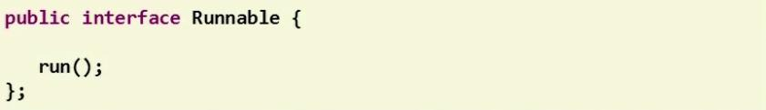
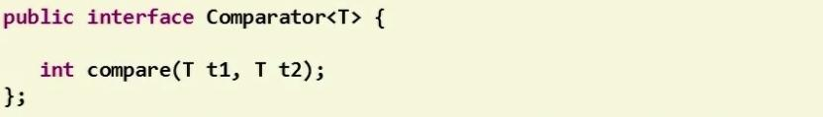
Functional Interface
New term of Java 8
A functional interface is an interface with only one abstract method.
Notes:
Functional Interface is a new term of Java 8
The functional interface is an normal interface with only one abstract method.
Take a look at the example here, the well-known Runnable and Comparator interface are now become functional interface, so what we can see here that the term of functional interface is new but all the interfaces back from previous Java versions are becoming functional interface without any needed of modification.

Slide 18
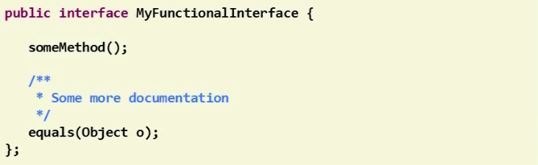
Functional Interface
Methods from the Object class don’t count.
Notes:
When we count the abstract method from an interface to check if it’s functional interface or not. The methods from Object class don’t count.
Why some methods of the Object class sometimes are added to an interface? But most of the time and this is the reason because someone would like to redeclared methods from Object class in the interface in order to extend comments from Object’s class in order to give some special semantic and to add javadoc that might be different from Object class.
http://grepcode.com/file_/repository.grepcode.com/java/root/jdk/openjdk/6-b14/java/util/Comparator.java/?v=source

Slide 19
Functional Interface
Annotation in Functional Interface
Notes:
By the default, the compiler of Java will automatically check if interface is a functional interface or not.
But for convenience, the functional interface can be annotated inside the code.

Slide 20
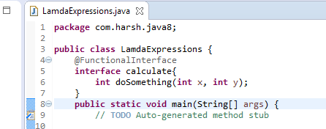
Functional Interface
A functional interface can be annotated.
It’s optional.
Notes:
It can be annotated by adding @FunctionalInterface on the top of the interface like the example below.
By doing so, the IDE will help you to detect if it is a functional interface before compiler do its job.

Slide 21
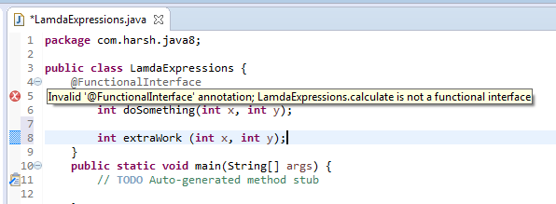
Functional Interface
Show compile error when defined more than one abstract method.
Notes:
In this example, I declared another abstract method in the functional interface and as you can see, with the annotation, the IDE will check and show an error message that this interface is not a functional interface. So you can immediately notice and correct the problem.

Slide 22
Functional Interface
Functional Interfaces
Toolbox
Notes:
With the new term of functional interface defined in java 8.
It also includes a brand new sets of functional interfaces.

Slide 23
Functional Interface
Brand new java.util.function package.
Each functional interface has a single abstract method.
Functional interfaces can provide a target type in multiple contexts
Rich set of function interfaces.
4 categories:
Supplier : Represents a supplier of results.
Consumer : accepts a single input argument and returns no result.
Predicate :predicate (boolean-valued function) of one
argument.
Function :accepts one argument and produces a result
Notes:
All these functional interfaces are defined in new package named java.util.function.
It contains around 43 interfaces and grouped into 4 categories as I listed below: Supplier, consumer, predicate, function.
You will see and use it a lot when you working with Java 8 and lambda expression.
In the scope of this presentation I will not go and explain for every interfaces. Instead, I will pick one of them to give you an example.

Slide 24
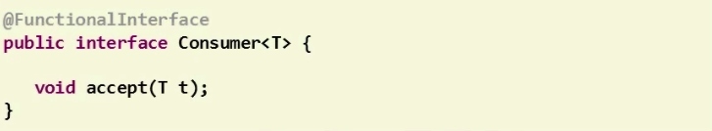
Consumer Interface
Accept an object and return nothing.
Can be implemented by lambda expression.

Slide 25
DEFAULT Methods
Default Methods

Slide 26
DEFAULT Methods
Java 8 has a new feature called Default Methods.
It is now possible to add method bodies into interfaces.
public interface Math {
int add(int a, int b);
default int multiply(int a, int b) {
return a * b;
}
}

Slide 27
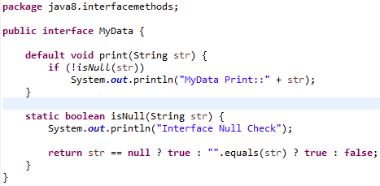
DEFAULT Methods
Interface Default and Static Methods
Syntax
[modifier] default | static returnType nameOfMethod (Parameter List) { // method body }
Notes:
Classes implement interface that contains a default method, they can perform following:
- Not override the default method and will inherit the default method - Override the default method similar to other methods we override in subclass - Redeclare default method as abstract, which force subclass to override it

Slide 28
DEFAULT Methods
What about Multiple Inheritance?
interface Person { default void sayHello() { System.out.println("Hello"); } } interface Male { default void sayHello() { System.out.println("Hi"); } } class Sam implements Person, Male { }
//override the sayHello to resolve ambiguity
void sayHello() {
}

Slide 29
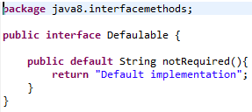

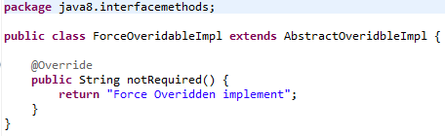
DEFAULT Methods
Classes implement interface that contains a default method
Not override the default method and will inherit the default method
Override the default method similar to other methods we override in subclass
Redeclare default method as abstract, which force subclass to override it
Notes:
Classes implement interface that contains a default method, they can perform following:
- Not override the default method and will inherit the default method - Override the default method similar to other methods we override in subclass - Redeclare default method as abstract, which force subclass to override it

Slide 30
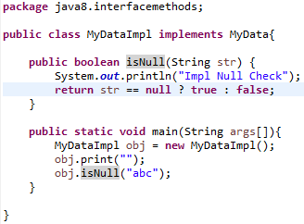
Static methods
Similar to default methods except that we can’t override them in the implementation classes

Slide 31


Method References
The method reference Person::compareByAge is semantically the same as the lambda expression (a, b) -> Person.compareByAge(a, b). Each has the following characteristics:
Its formal parameter list is copied from Comparator<Person>.compare, which is (Person, Person).
Its body calls the method Person.compareByAge.
There are four kinds of method references:
Method Reference Type | Example
Reference to a static method | ContainingClass::staticMethodName
Reference to an instance method of a particular object | containingObject::instanceMethodName
Reference to an instance method of an arbitrary object of a particular type | ContainingType::methodName
Reference to a constructor | ClassName::new

Slide 32
Method References
Since System.out is an instance of type PrintStream, we then call theprintln method of the instance.
Lambda Form | ReferenceToInstanceMethod.printNames (names, x -> System.out.println(x));
Method Reference | ReferenceToInstanceMethod.printNames (names,System.out::println);

Slide 33
Method References
You can use replace Lambda Expressions with Method References where Lambda is invoking already defined methods.
You can’t pass arguments to methods Reference

Slide 34
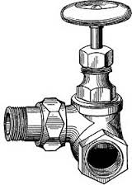
STREAMS

Slide 35
Stream
What is a Stream?

Slide 36
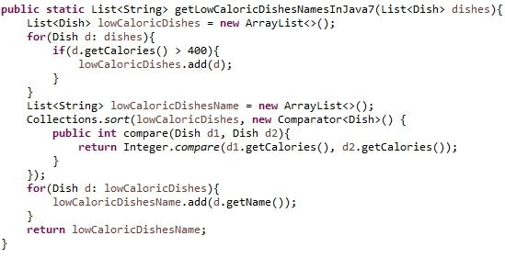
Stream
Old Java:
Notes:
Let’s talk about why the stream is efficient.
Nowaday, most of computer are using multiple CPUs, so we will take advantages of that to the stream in order to process data parallelly.

Slide 37
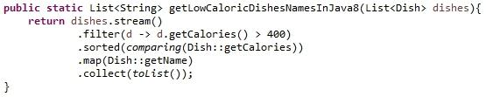
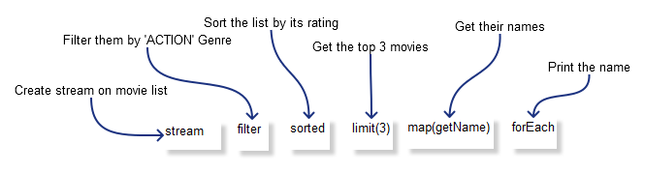
Stream
Java 8:
Another example:
Notes:
Let’s talk about why the stream is efficient.
Nowaday, most of computer are using multiple CPUs, so we will take advantages of that to the stream in order to process data parallelly.

Slide 38
Stream
Not store data
Designed for processing data
Not reusable
Can easily be outputted as arrays or lists

Slide 39
Stream - How to use
1. Build a stream
2. Transform stream
3. Collect result

Slide 40
Stream - build streams
Build streams from collections
List<Dish> dishes = new ArrayList<Dish>();
....(add some Dishes)....
Stream<Dish> stream = dishes.stream();

Slide 41
Stream - build streams
Build streams from arrays
Integer[] integers =
{1, 2, 3, 4, 5, 6, 7, 8, 9};
Stream<Integer> stream = Stream.of(integers);

Slide 42
Stream - Operations
Intermediate operations (return Stream)
filter()
map()
sorted()
Etc.
Notes:
Intermediate operations return the stream itself so you can chain multiple method calls in a row. Let’s learn important ones.

Slide 43
Stream - filter()
// get even numbers
Stream<Integer> evenNumbers = stream
.filter(i -> i%2 == 0);
// Now evenNumbers have {2, 4, 6, 8}
Notes:
Intermediate operations return the stream itself so you can chain multiple method calls in a row. Let’s learn important ones.

Slide 44
Stream - Operations
Terminal operations
forEach()
collect()
match()
….
Notes:
Terminal operations return a result of a certain type instead of again a Stream.

Slide 45
Stream - forEach()
// get even numbers
evenNumbers.forEach(i ->System.out.println(i));
/* Console output
* 2
* 4
* 6
* 8
*/
Notes:
Intermediate operations return the stream itself so you can chain multiple method calls in a row. Let’s learn important ones.

Slide 46
Stream - COLLECT()
Converting stream to list
List<Integer> numbers = evenNumbers.collect(Collectors.toList());
Converting stream to array
Integer[] numbers = evenNumbers.toArray(Integer[]::new);
Notes:
Intermediate operations return the stream itself so you can chain multiple method calls in a row. Let’s learn important ones.

Slide 47
java.util.stream.*
New package for filter/map/reduce transformations on streams
Includes many useful built in aggregate operations
int avg = Arrays.stream(personArr)
.filter(b -> b.getGender() == Gender.MALE)
.mapToDouble(Person::getSalary)
.average()
.getAsDouble();
‘persons’ is a Collection<Person>

Slide 48
Why use Streams?
No storage
A stream is not a data structure that stores elements
it conveys elements from a source (Array,Collection,IO Channel etc) through a pipeline of computational operations
stream operation produces a result without modifing its source
Functional in nature
Enable Functional way of Working with Databases – Easy and elegant
Parallelism
Streams facilitate parallel execution by reframing the computation as a pipeline of aggregate operations
Consumable
The elements are visited only once during the life of a stream.
new stream must be generated to revisit the same elements

Slide 49

DATE TIME API

Slide 50
Date-Time Packages
Drawbacks of old date-time API
Not thread safe
Poor design
Difficult time zone handling
Java 8 introduces a new date-time API under the package java.time.
Local − Simplified date-time API with no complexity of timezone handling.
Zoned − Specialized date-time API to deal with various timezones.

Slide 51
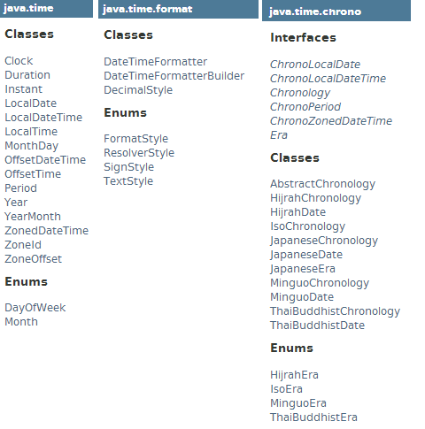
Date-Time Packages
JavaSE 6
Date
Calendar
DateFormat
TimeZone
Java 8

Slide 52
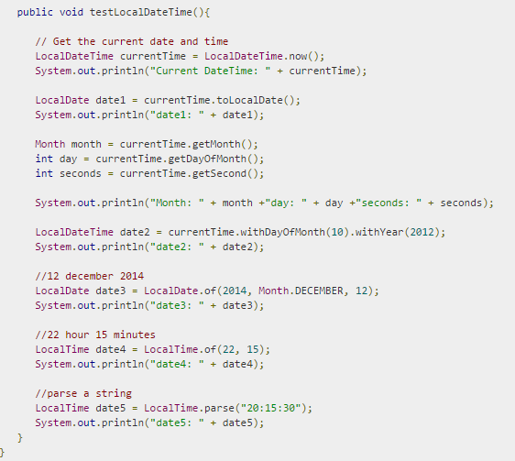
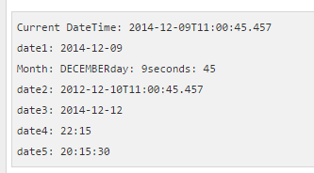
Local Data-Time API

Slide 53
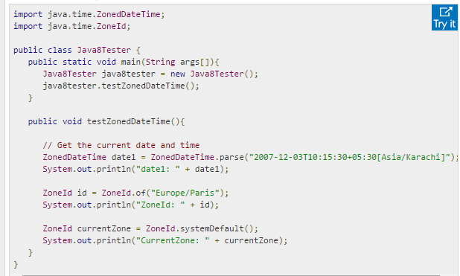

Zoned Data-Time API

Slide 54
Concurrent HashMap Enhancements
Streams & Lambda expression based new methods
forEach methods
forEach, forEachKey, forEachValue, and forEachEntry
search methods
search, searchKeys, searchValues, and searchEntries
reduction methods
reduce, reduceToDouble, reduceToLong …
-> ConcurrentHashMaps (and classes built from them) are more useful as cache

Slide 55


Annotations
Repeating Annotations
provide the ability to apply the same annotation type more than once to the same declaration
Type Annotations
provide the ability to apply an annotation anywhere a type is used, not just on a declaration.
Used with a pluggable type system,
this feature enables improved type checking of your code

Slide 56
Nashorn Javascript Engine
Lightweight, high-performance script engine
Implemented in Java by Oracle
Replaces Mozilla Rhino JavaScript interpreter
Rhino compiled all JavaScript code to bytecode in generated class files.
Compared to C implementation of Javascript run with JIT compilation, Rhino had better performance
Rhino had memory leak since most JVMs don’t clean unused classes
Nashorn
compiles scripts in memory and passes bytecode directly to JVM

Slide 57
JDBC
The JDBC-ODBC Bridge has been removed
Reason
The JDBC-ODBC Bridge had been non-supported product
Was provided with only selected JDKs and not included in JRE
Alternate recommendation
Use a JDBC driver provided by the database vendor
If it was in use to with MS Access DB or Excel spreadsheet etc, could be replaced by pure java DB like H2, Java DB etc.
JDBC 4.2
Minor enhancements to JDBC to improve usability and portability
JDK 8 includes Java DB 10.10
a version of the Apache Derby database (since Java 5)

Slide 58

ThE END

Slide 59
Java FX
Enriched 3D Graphics features
New SwingNode class
SwingNode - enables embedding Swing content into JavaFX
ScheduledService - allows to automatically restart the service
Enhanced text support
Hindi and Thai controls
New Styles - bi-directional text, multi-line etc
Now Compatible with ARM platforms

Slide 60
HTTP URL Permission
URLPermission Represents permission to access
a resource defined by url
for a given set of user-settable request methods and request headers
URLPermission(String url_name, String actions)
name of the permission is the url string
http://www.oracle.com/a/b/*
actions string is a concatenation of the request methods and headers
"POST,GET,DELETE“
"POST,GET:Header1,Header2“
Examples of Path Matching
public boolean implies(Permission p)
This’s path | P’s path | Matches /implies
/a/b/* | /a/b/c | Yes
/a/b/* | /a/b/c/d | No
/a/b/- | /a/b/c/d/e | Yes

Slide 61
Security
KeyStore enhancements
new Domain KeyStore type java.security.DomainLoadStoreParameter
new command option - importpassword for the keytool utility
New variant of AccessController.doPrivileged
enables code to assert a subset of its privileges, without preventing the full traversal of the stack to check for other permissions
Support for
Stronger algorithms for password-based encryption
AEAD algorithms
SHA-224 Message Digests
rcache Types in Kerberos 5 Replay Caching

Slide 62
HotSpot VM
Leverage CPU Instructions for AES Cryptography
Intel Westmere hardware (2010 or newer) has instruction set to support AES (Advanced Encryption Standard)
Syntax: -XX:+UseAES -XX:+UseAESIntrinsics
JMC 5.3
JMC (Originally developed by JRockit) is an advanced set of tools that enabling efficient JVM monitoring & profiling
JMC is bundled with the HotSpot JVM starting from Java SE 7u40

Slide 63
Tools
New Commands
Jjs – invoke Nashorn java script engine
Java – can launch JavaFX
Jdeps - analyze class files
Pack200
Pack200 support for Constant Pool Entries and New Bytecodes

